Slide 1

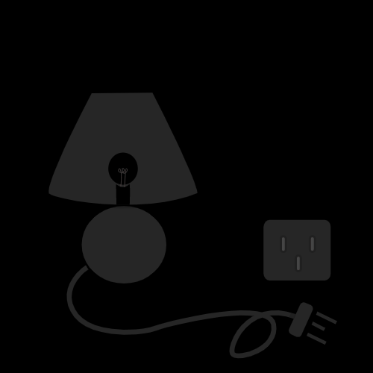

Home Electricity Forecast
St. Francis Institute of Technology
Information Technology
IoE Mini Project (ITL802)
Akshay Gunjal 34
Shaun Dsilva 35
Davon Carvalho 36
Guide : Prof. Vaishali Salvi

Slide 2

Overview
Introduction
Problem Statement
Literature survey
Circuit diagram
System design
System requirements
Conclusion
References

Slide 3
Introduction
Introduction to IoE: Internet of Everything (IoE) as bringing together people, process, data, and things to make networked connections more relevant and valuable than ever before-turning information into actions that create new capabilities, richer experiences, and unprecedented economic opportunity for businesses, individuals, and countries.
Introduction to domain : You must have your traditional energy meters at home that generates bill every month, too boring. We can make our own smart energy meter that generates bill every minute which we can see on your smart phone or laptop.
Introduction to problem : Checking the number of units consumed on our electricity meter every time is very difficult as it can be located at uneasy places. Smart Home Electricity forecast is useful in this situation.
Proposed solution : Smart Home Electricity forecast systems cover a range of products that use a combination of technologies to identify how much energy is been consumed by every electric product. This is useful to calculate the actual amount of electricity bill that we receive every month.

Slide 4

Problem Statement
This project aims to build a Home Electricity forecast system using various sensors, which will be efficient for people to know their monthly consumption of every electric appliance that they use and calculate the estimated bill amount.

Slide 5
Literature Survey
 | Summary | Gaps Identified
[1] | This article applied these concepts to home energy monitoring system and create an application to forecasting the user’s electricity bill. The system has applications programming interface (API) that allow users to create applications upon their requirements. | 87% data was available but 13% data was lost due to low signal in Wi-Fi connectivity.
[2] | This model consists of three sub models: user electricity consumption sub model, renewable energies sub model(solar cells and wind turbines) and EVs power consumption and storage sub model. All these sub models together build an accurate model that provides low error predictions for EMSs. | Was not able to produce estimate consumption of ample households.
[3] | This paper proposes a novel forecast method for individual household electricity loads. Besides using smart meter data together with weather and temporal variables this approach integrates the information contained in typical daily consumption profiles extracted by clustering and classification methods.. | The method still remains practical in terms of data requirements as it mostly utilizes smart meter data. Most energy companies do not own detailed survey information of households.
[4] | The goal of this paper is to benchmark state-of-the-art methods for forecasting electricity demand on the household level across different granularities and time scales in an explorative way, thereby revealing potential shortcomings and ﬁnd promising directions for future research in this area. | This paper was having a limited data.

Slide 6
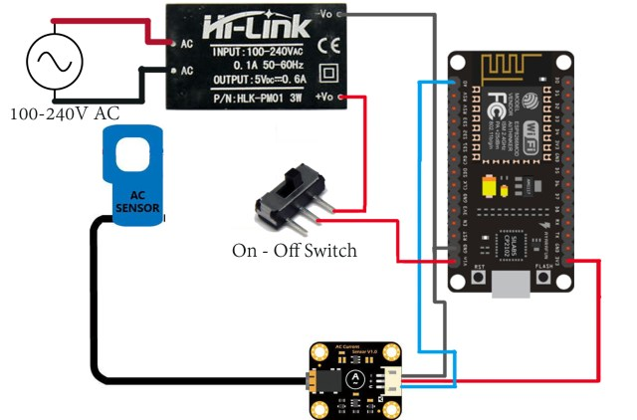


Circuit Diagram
220 * Current(CTSensor) *5.36
60000
Rs.5.36/unit(1kWt)
220 Volts
Fig 2. System Circuit Diagram

Slide 7
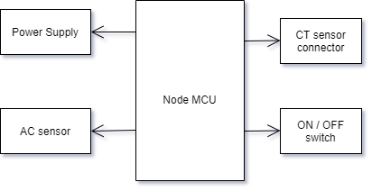
System Design
Fig 1. System Block Diagram

Slide 8
System Requirements
Hardware / Software | No. Required | Cost of per Component
Node MCU | 1 | 200/- Rs.
CT Sensor | 1 | 600/- Rs.
On / Off Switch | 1 | 10/- Rs.
Breadboard | 1 | 70/- Rs.
Connectors | As per requirement | -
Power supply | 1 | -
Arduino IDE | - | -
Ubidots | - | -
 |  | Total – 880/- Rs.

Slide 9
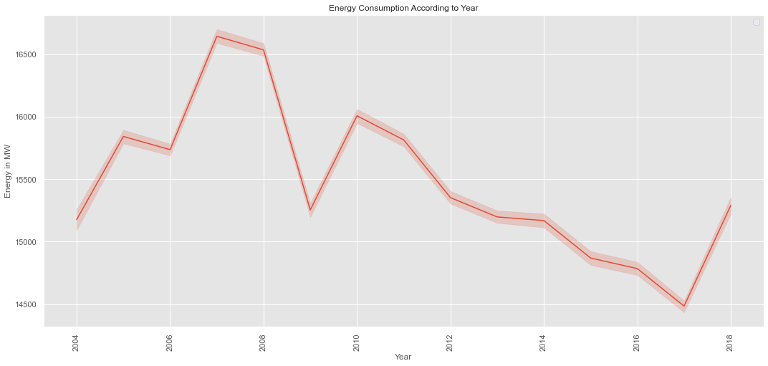
Analysis
Fig. 3 Energy in MW Vs Year

Slide 10
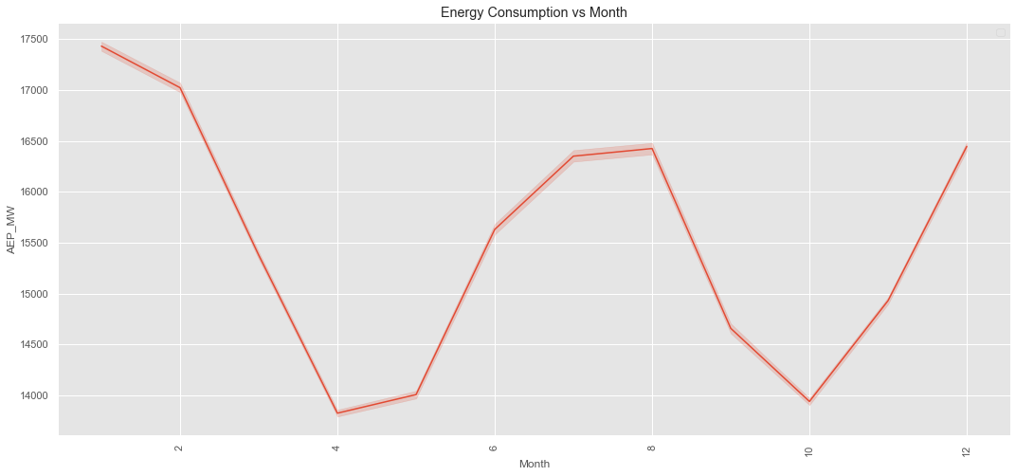
Analysis
Fig. 4 Energy in MW Vs Month

Slide 11
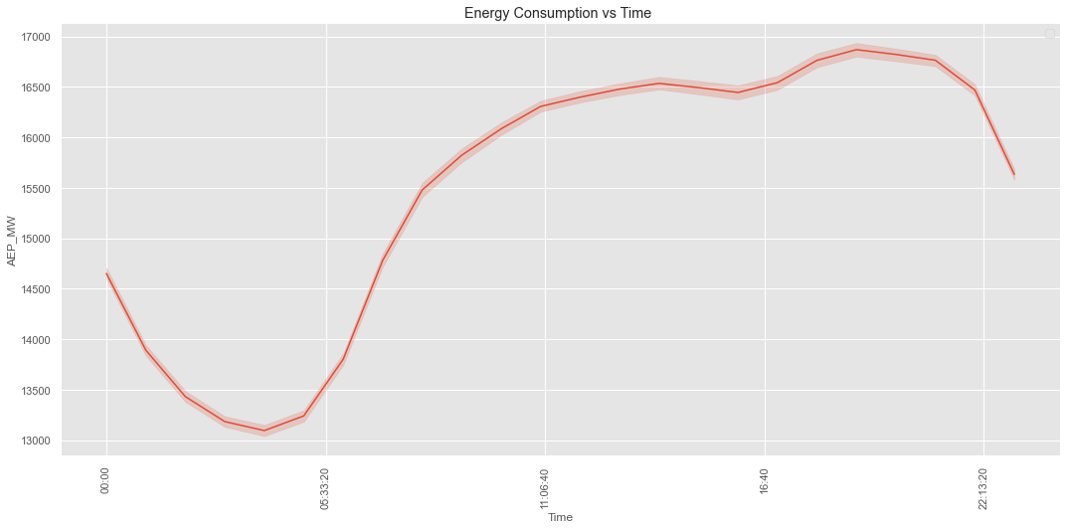
Analysis
Fig. 5 Energy in MW Vs Time

Slide 12
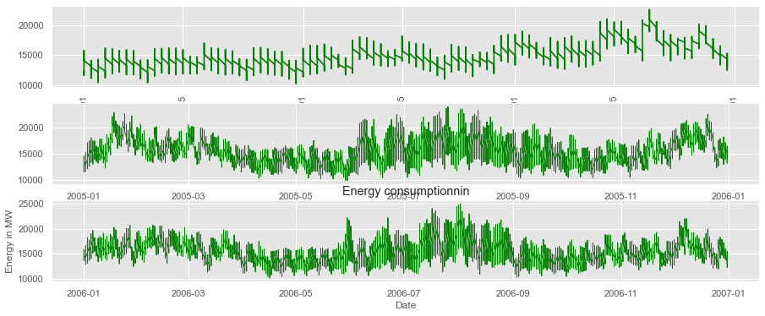
Analysis
Fig. 6 Energy in MW Vs Date

Slide 13
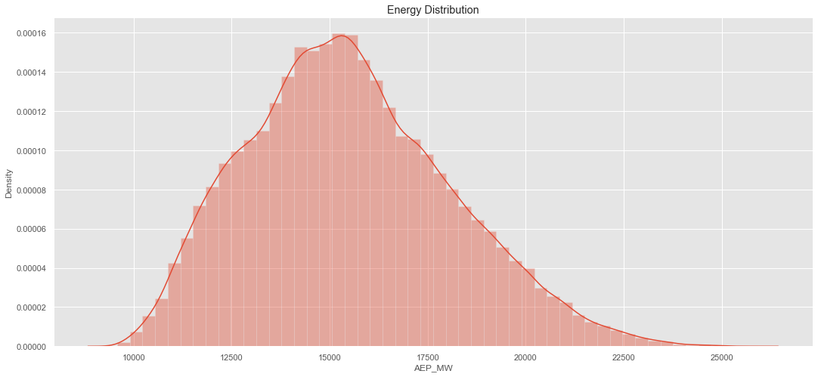
Analysis
Fig. 7 Energy Distribution

Slide 14
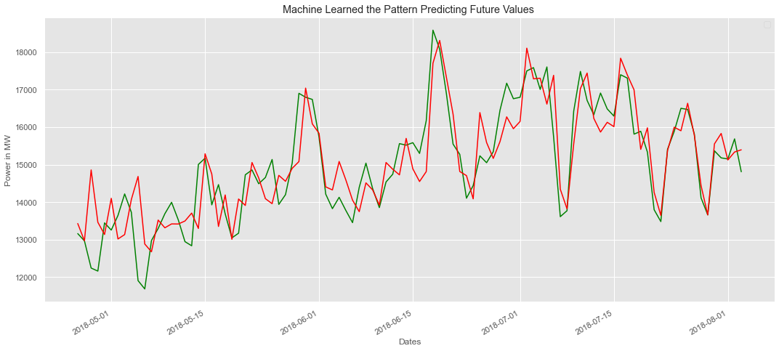
Analysis
Fig. 8 Predicted Energy Consumption

Slide 15
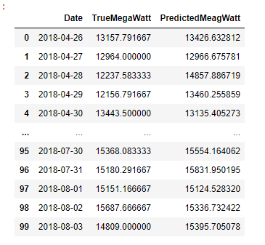
Analysis
Fig. 8 Predicted Energy Consumption

Slide 16

Conclusion
Home Electricity Forecast is becoming increasingly important in our homes as it keeps track of the daily units consumed by our electrical appliances. Thereby giving us an opportunity to save electricity by future predictions. This technology also helps us in avoiding unnecessary wastage of electricity.

Slide 17
References
[1] Chupong, Charnon, and Boonyang Plangklang. "Electricity bill forecasting application by home energy monitoring system." In 2017 International Electrical Engineering Congress (iEECON), pp. 1-4. IEEE, 2017.
[2] FARAHNAKIAN, Mohammad YAGHMAEE Mohammad Ali, Reyhaneh HAJIMAHDIZADEH, Mohsen ZABIHI, and Tavanir-Iran MEEDC-Iran. "POWER CONSUMPTION FO POWER CONSUMPTION FORECASTING IN THE PRE RECASTING IN THE PRESENCE OF SENCE OF DISTRIBUTED GENERATIO ISTRIBUTED GENERATION AND STORAG N AND STORAGE IN SMART HOME E IN SMART HOME." Renewable Energy 2: 2.
[3] Yildiz, Baran, Jose I. Bilbao, Jonathon Dore, and Alistair Sproul. "Household electricity load forecasting using historical smart meter data with clustering and classification techniques." In 2018 IEEE Innovative Smart Grid Technologies-Asia (ISGT Asia), pp. 873-879. IEEE, 2018.
[4] Veit, Andreas, Christoph Goebel, Rohit Tidke, Christoph Doblander, and Hans-Arno Jacobsen. "Household electricity demand forecasting: benchmarking state-of-the-art methods." In Proceedings of the 5th international conference on Future energy systems, pp. 233-234. 2014.

